Slide 1

GOOD MORNING EVERYONE!

Slide 2



PRESENTERs
MD. abu towsif
Farjana yESMIN opi
Md. Shohanur Rahman Shohan

Slide 3


OUTLINE
Conclusion
Game Description
Basic Functionality
Introduction
Objective
Project Demonstraton

Slide 4
OBJECTIVE
To develop a desktop application named 'Khela Ghor' in C# using Windows Forms (. Net Framework), providing users with a platform for playing various small games mainly in offline mode. The project also focuses on implementing a secure user account management, allowing customization of profiles, leaderboards to enhance user engagement.

Slide 5
Introduction
The 'Khela Ghor' project aims to deliver a versatile desktop application offering a diverse collection of small games within a unified platform. The solution involves implementing a secure and user-friendly environment where players can create accounts, customize profiles, and engage in various mini games to enrich their gaming experiences. By incorporating features such as leaderboards, high scores 'Khela Ghor' strives to enhance user engagement and create a vibrant gaming community.. Overall, 'Khela Ghor' seeks to provide a comprehensive and enjoyable gaming experience for users while adhering to best practices in design, functionality, and user interaction.

Slide 6
Basic Functionality
Game Collection
Game details
User Account Management
Login feature
An user can enter in the app with loging In. If an user choose to login then he/she will able to create a 'Khela Ghor' account (user account)
Secure user authentication and account creation.
Profile customization with options for unique usernames.
The highest scores of every game can be saved inside the ‘Khela Ghor’ app.
Access to a diverse collection of small games within the desktop application.
Single-player gaming experiences for users to enjoy.

Slide 7
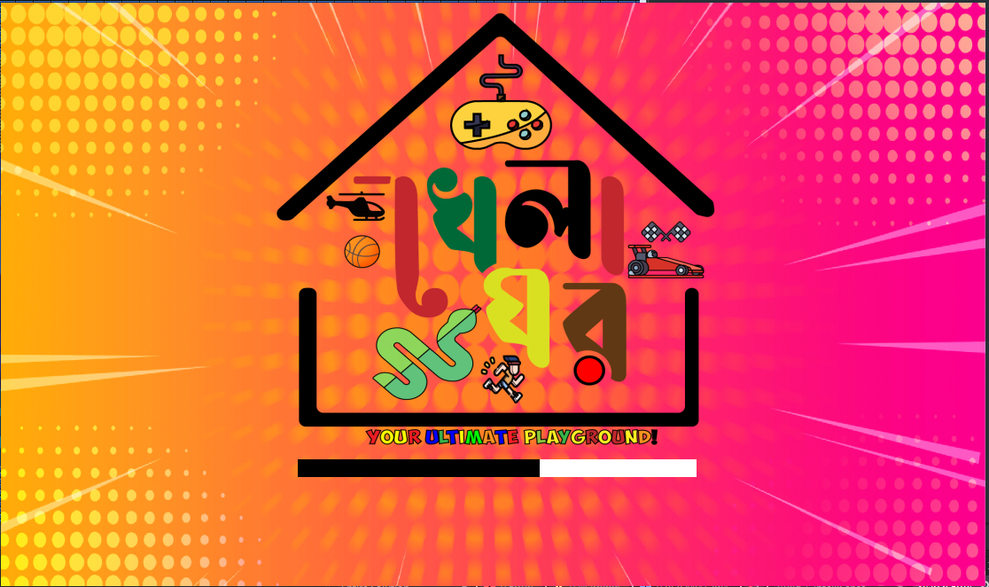
‘KHELA GHOR’ Icon in Bangla illustrated in Adobe Illustrator
Loading panel added with a timer

Slide 8
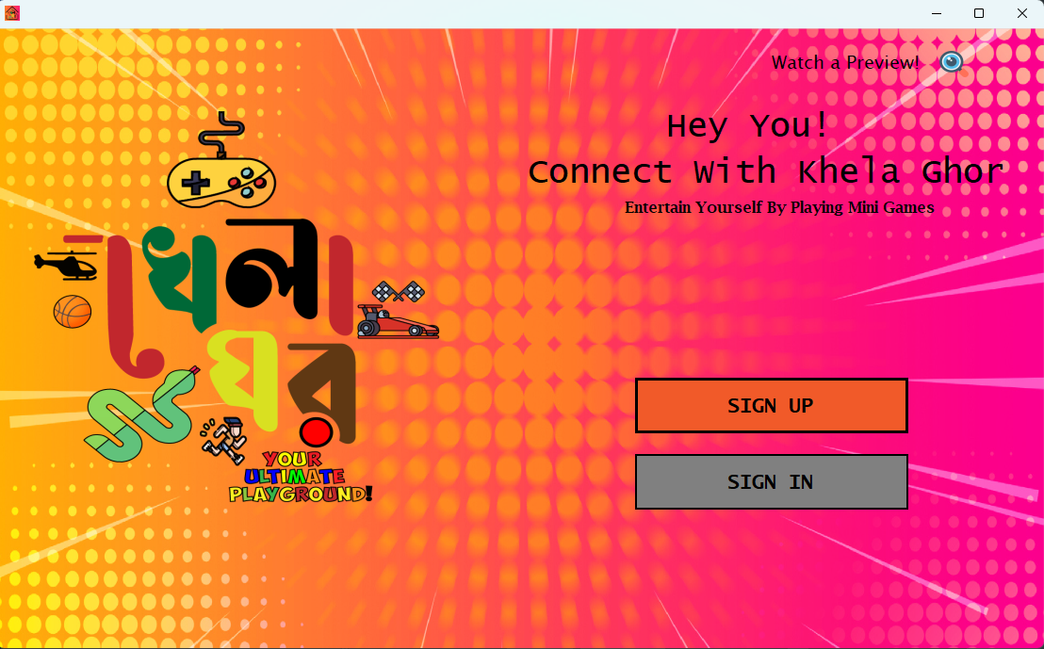
Preview button , clicking on it users can see a preview of the mini games collectons
Sign Up button. Pressing this button will open the sign up page
Welcome labels
Sign Up button. Pressing this button will open the sign up page

Slide 9
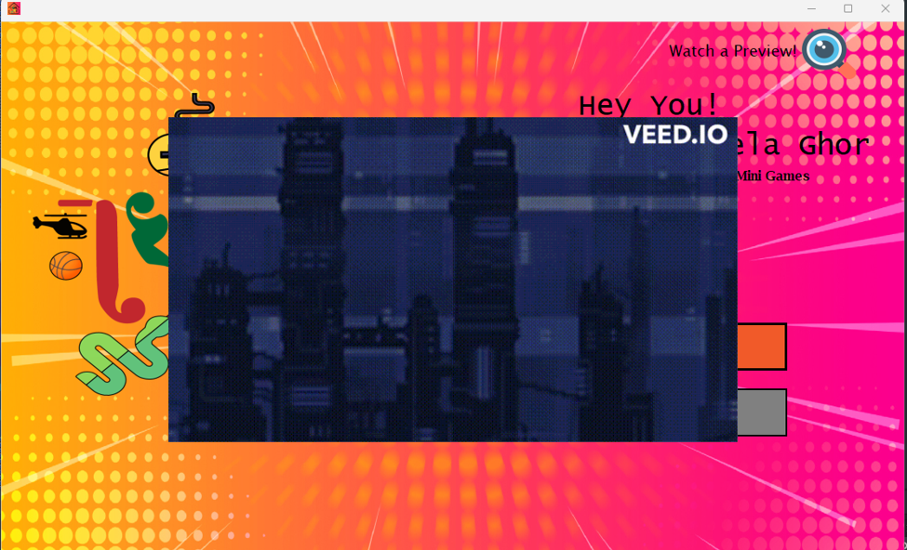
The preview button is being pressed
A preview window opend

Slide 10
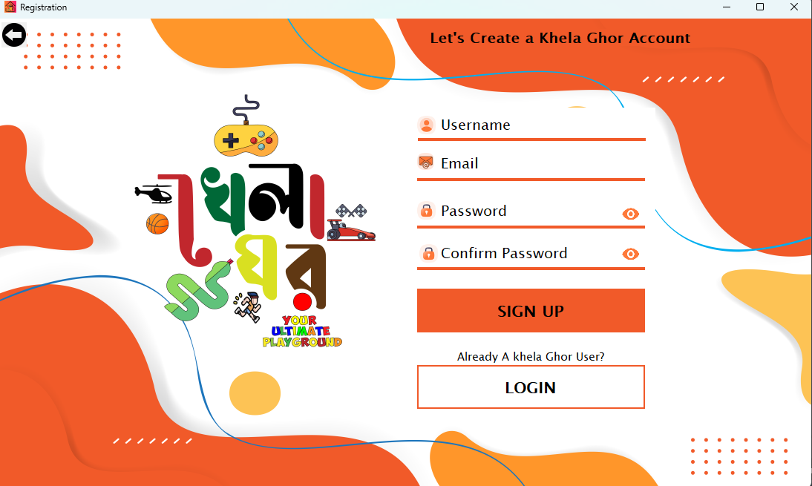
The preview button is being pressed
Username text Box
Email text Box
Password text Box
Confirm Password text Box
If all the given data is valid, then pressin this button will create a account for the user
Login Button for users having account already

Slide 11
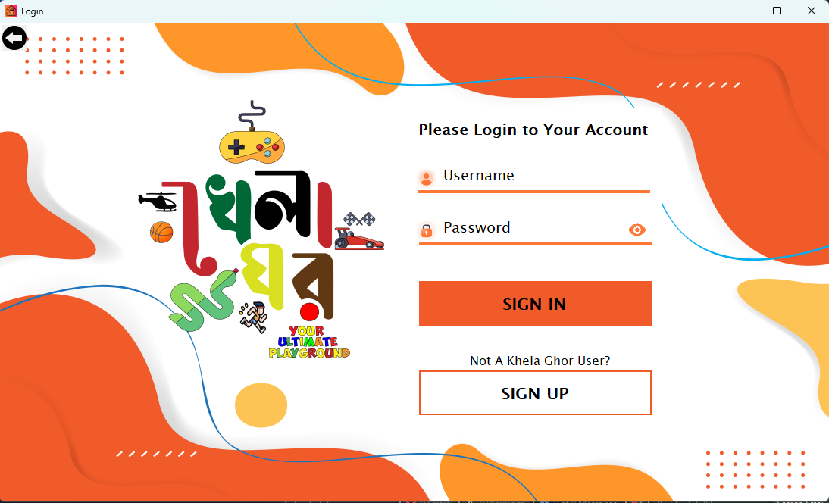
Back button
Login Label
Email text Box
Password text Box
If all the given data is valid, then pressing this button will logged in the dashboard page for the user
Login Button for users having account already

Slide 12
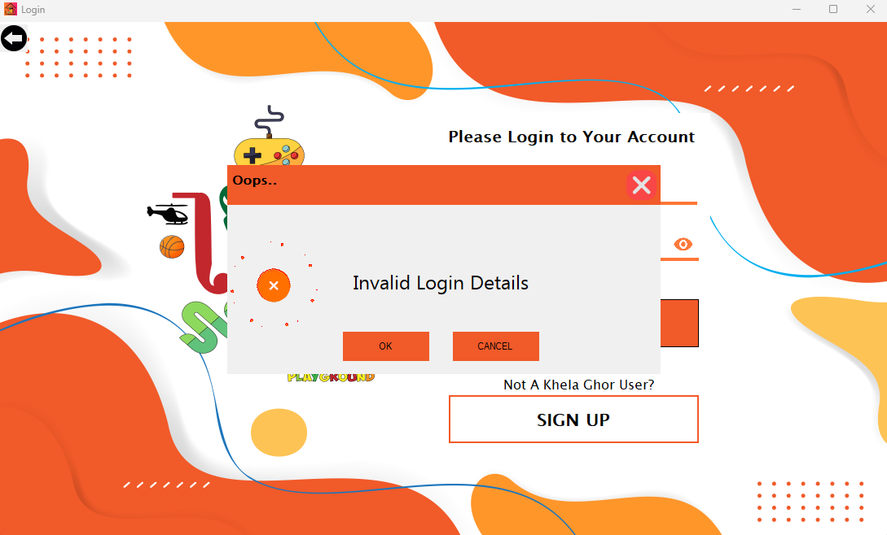
A popup window will appear if user gives invalid login details with a animated picture box
Pressing OK button will close the invalid popup window and erase the text’s of password textbox

Slide 13
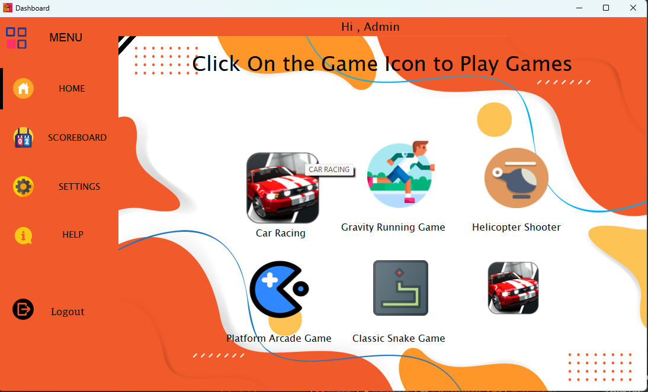
We are on the Dashboard page because user gave correct login details in the lagin page..
If user mouser hover on the game buttons then the size of the buttons will increase, if user click on the button the game will open
Dashboard Menu’s
Log Out button

Slide 14
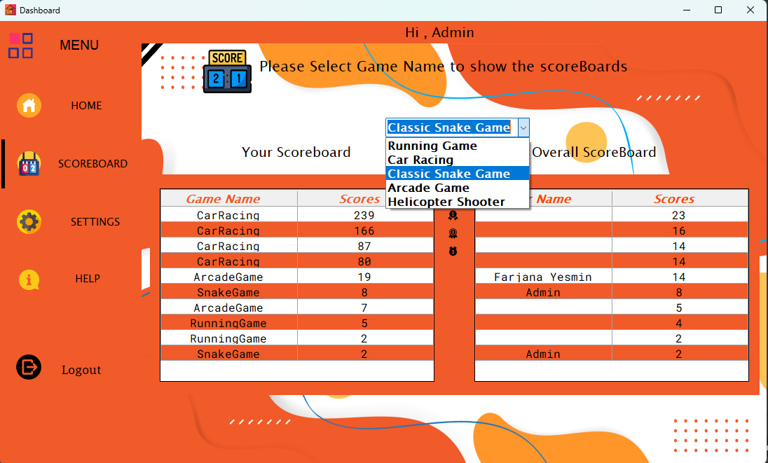
Combo box to choose among games to see scoreboards
We are in the Scoreboard Menu
Overall Scoreboard of individual games
Individual scoreboard of player

Slide 15
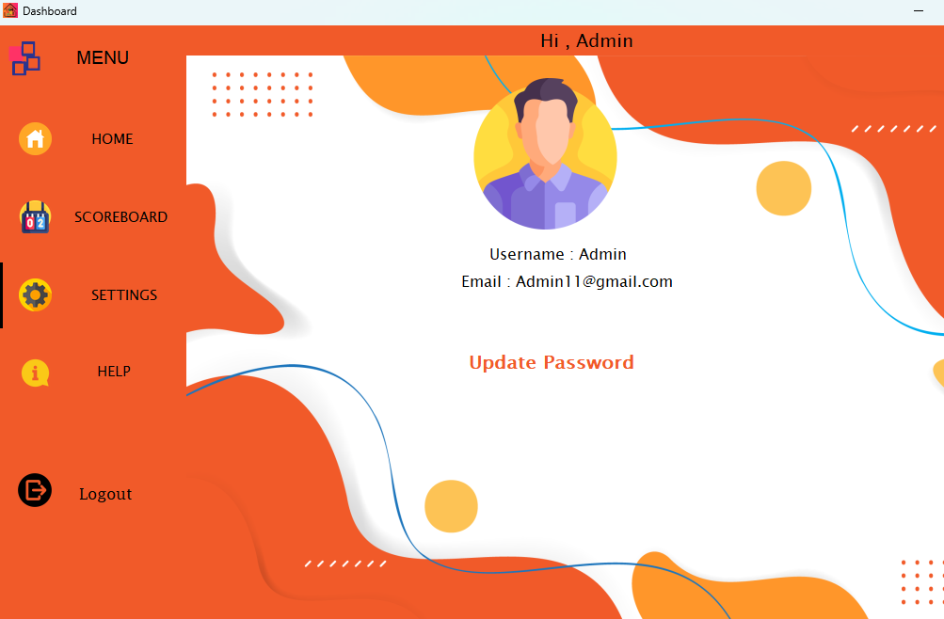
User Name and the Email of the logged in User will be shown here
We are on the Settings menu
Users can Update their Password from Settings Menu

Slide 16
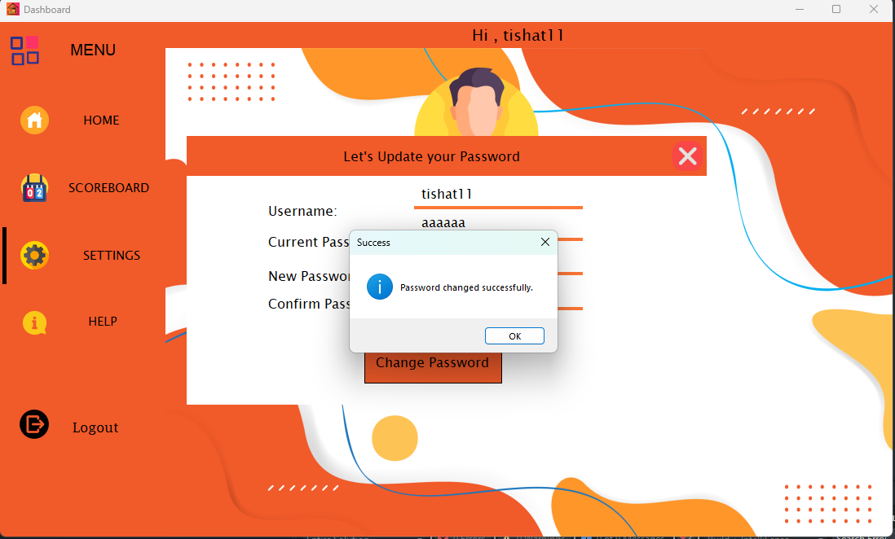
Password Resetting window for changing the password
If user give all the details correctly, then a successful message box will pop up

Slide 17
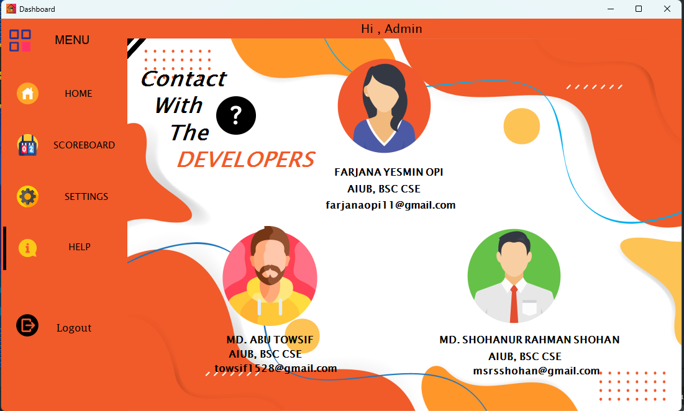
Details of the developers of this project
We are on the Help menu

Slide 18

Games
5
3
1
4
2
Gravity Running Game
Car Racing
Helicopter shooter
Classic Snake Game
Arcade game

Slide 19

Gravity Run
This is basically a running game avoiding obstacles. In this game:
•Players will be given a character to jump over the obstacles coming in front of them.
•There will be obstacles to stop players. Players must jump over the obstacle to gain more points.
•The high score of the game can be saved and displayed.

Slide 20
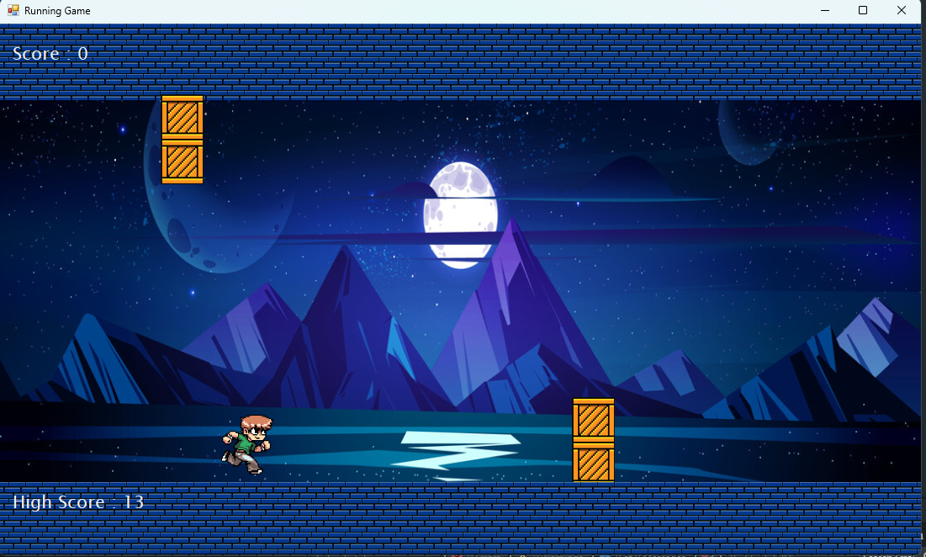
Score Label. Players can their score in real time
Game Background Image
This is the player figure which the user will control from the space bar key. Users must avoid crashing with the wooden objects to be in the game. The running speed of the player will increase for every 10 points of the user
Wooden Obstacles. These Obstacles will move and appear from right position of the screen randomly. The speed of the obstacles will increase for every 10 points increase of the player
Platforms in which the player figure will land
High Score Label. When the game will load, High Score will be shown from the Leader board table from the database. If a player obtain high score, then it will change in real time

Slide 21
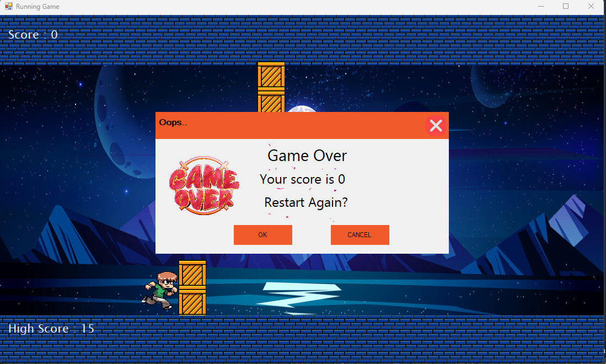
A Pop Up window will appear when the game over with the obtained score of the player and a game over sound effect
Player Crashed with the obstacle

Slide 22
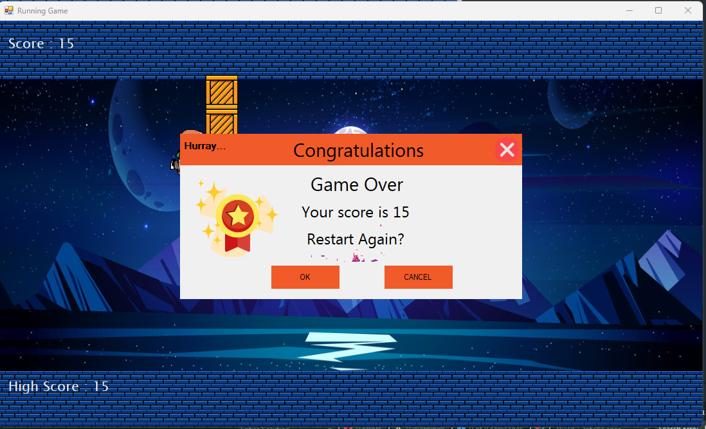
A Pop Up window will appear when the game over with the Highest score by the player and a win sound effect
Player crashed with the obstacle, but we have a new High score
New High Score.. It will save in LeaderBoard table

Slide 23

Car Racing
The game features a dynamic road, player-controlled car, other cars in the road, trophies, and an animated explosion. The objective is to drive as far as possible without colliding with other cars.
The game employs a dynamic road scrolling mechanism, creating a visually engaging experience as the road moves seamlessly, giving the illusion of the player's car advancing through the environment. Players control a car using responsive left and right arrow keys, aiming to navigate through traffic consisting of cars. The game offers a competitive edge with a scoring system that rewards players with bronze, silver, or gold trophies based on their performance, encouraging replay ability and competition among players. Upon collision, an animated explosion is triggered enhancing the gaming experience and providing immediate feedback to the player so that players can understand their run is come to an end. A restart button allows players to reset the game, providing a convenient way to replay and improve their performance without restarting the entire application.

Slide 24
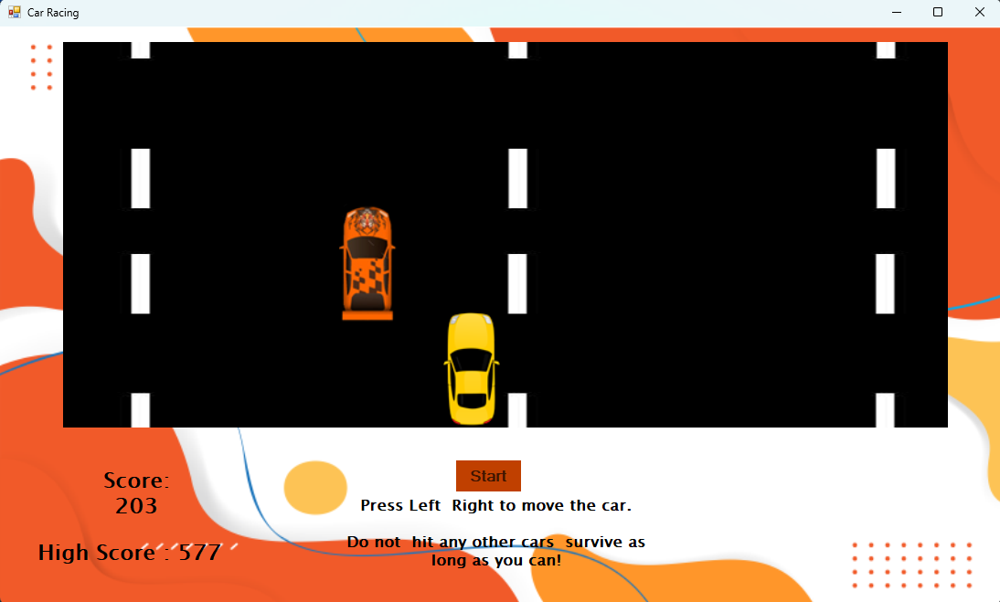
This car is placed as obstacle. It will move from bottom to the top of the road.
Player: This car represents the player figure of this game. It can be controlled by left and right keys. If this car touches the bounds of the obstacles the game will be over. User has to avoid the obstacles to survive in the game. The speed of the car will be increased with increasing score.
High Score Label: This label is used to showing the high score from the leader board table from the database
Score Label: Player can see their score in real time
Road Track

Slide 25
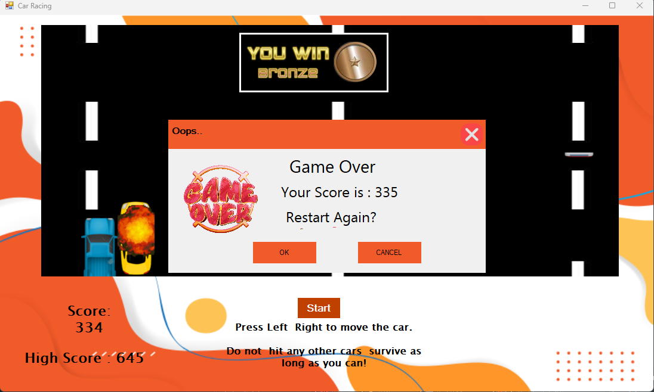
A Pop Up window will appear when the game over with the obtained score of the player and a game over sound effect
Player car is crashed with the obstacle car.

Slide 26
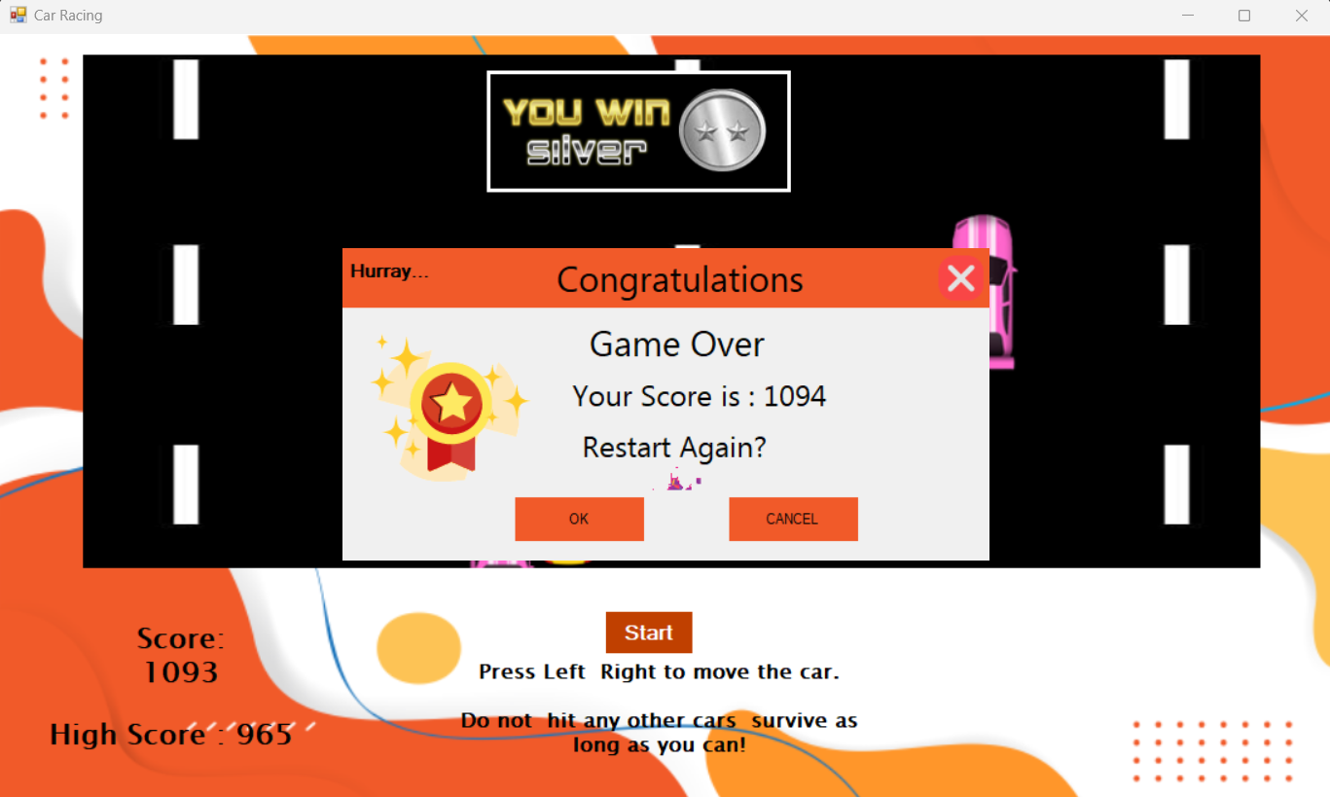
Whenever the will over, an award will appear according to the score.
A Pop Up window will appear when the game will over with the Highest score by the player and a win sound effect.
If we click on OK the game will be restarted.
If we click on CANCEL, the pop-up form will disappear. After that to start the game again, user has to click on the enter key.

Slide 27

Helicopter Shooter
In this game:
• A Helicopter will be given to the player to control.
• Players can move the Helicopter with the arrow keys.
• Players can eliminate the enemy vehicles by firing them with the Helicopter.
• Some horizontal block will be displayed to stop players Helicopter.
• A real time scoring of the game will be displayed.
• A player’s run will be over when he/ she hits the blocks.

Slide 28
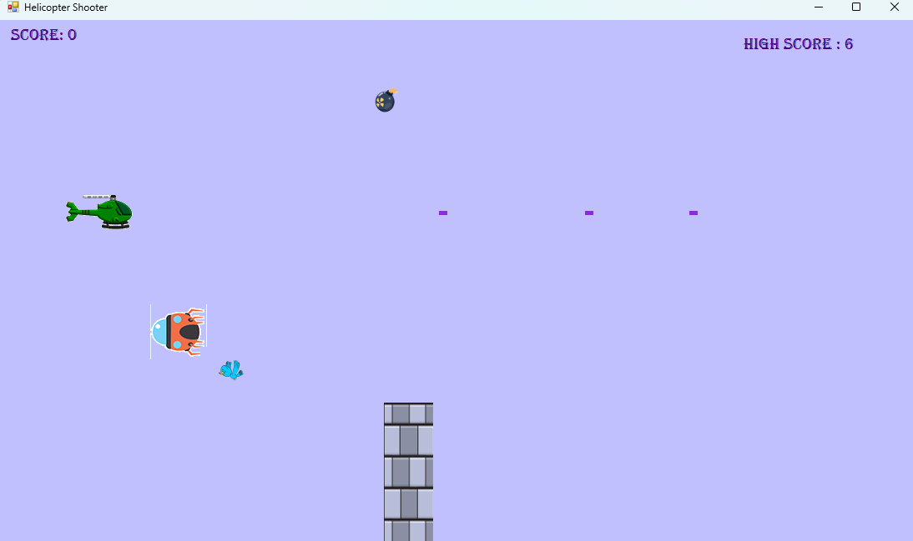
Score Label: Player can see their score in real time
Obstacle 2: This bomb will fall from the top and move to bottom of the screen. When the score will be above 10 the speed of it will be increased
High Score Label: This label is used to showing the high score from the leader board table from the database
Player: This helicopter represents the player figure of this game. It can be controlled by up, down, left and right keys. If helicopter touches the bounds of the obstacles the game will be over. User has to avoid the obstacles to survive in the game. The speed of the helicopter will be increased when score is increased by 10.
Bullet: This object is released by the helicopter controlled by the space bar. This is used to destroy the obstacles bird and ufo. With every elimination of the obstacles, the score is increased by 1.
Obstacle 3: This ufo will move and appear from the right side of the form randomly. When the score will be above 10 the speed of it will be increased
Obstacle 4: This bird will move and appear from the right side of the form randomly. When the score will be above 10 the speed of it will be increased
Obstacle 1: This pillar will move and appear from the right side of the form randomly.

Slide 29
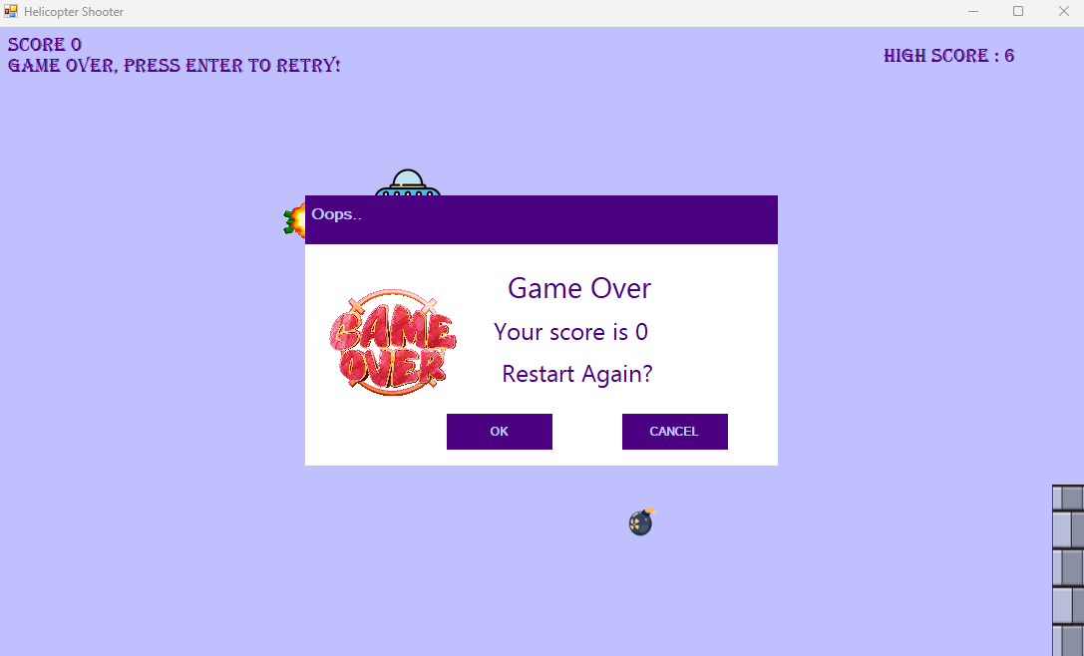
Helicopter is crashed with the obstacle.
A pop-up form will appear when the game will be over with the obtained score with sound effect.
If we click on OK the game will be restarted.
If we click on CANCEL, the pop-up form will disappear. After that to start the game again, user has to click on the enter key.

Slide 30

Classic Snake
The Classic Snake Game involves controlling a snake to eat food, growing longer with each meal.
Utilizes the Circle class to draw and manage the positions of snake and food objects. Responds to key events for snake movement, with options for left, right, up, and down directions. Tracks and displays the current score, updating as the snake consumes food. Detects collisions with the snake's own body, triggering a game over event. Displays the final score and allows restarting. Generates food at random positions within the game boundaries for varied gameplay. Keeps track of the highest score achieved during gameplay sessions.

Slide 31
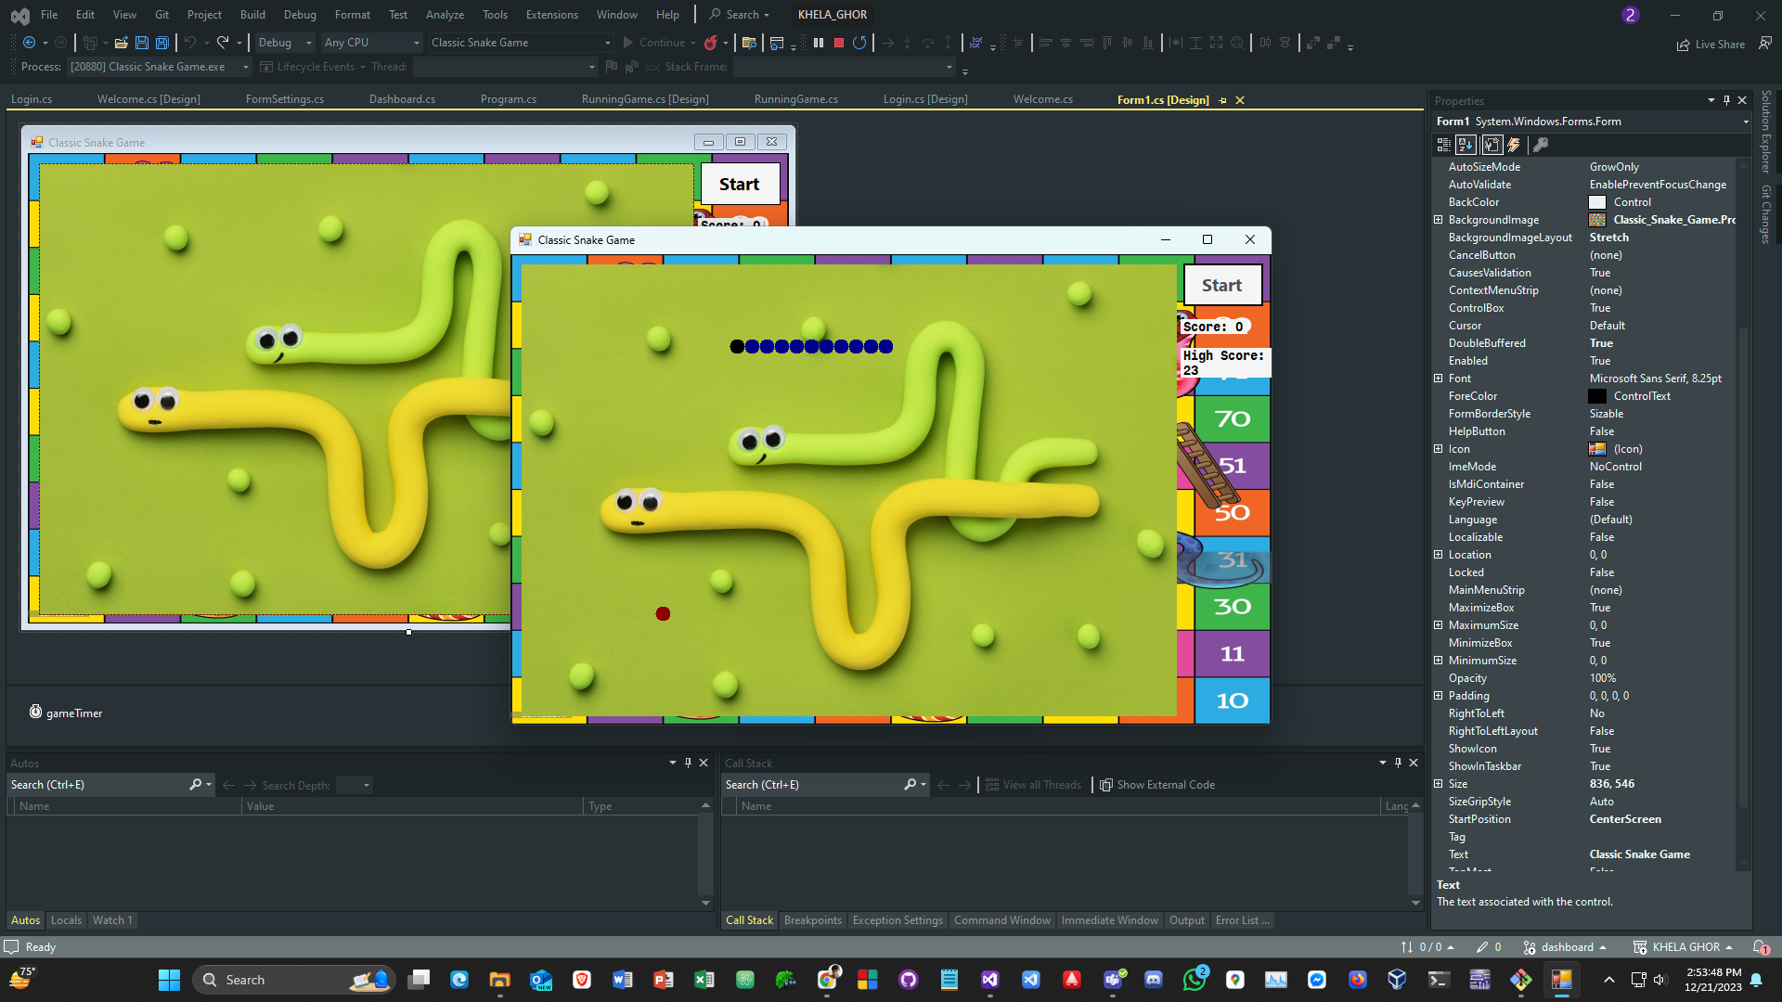
Start Button
Snake
Score Label
High Score Label
Food

Slide 32

Arcade Game
• The game will have a user-friendly interface that displays the current score, highest score, and any relevant game information.
• The game will have platforms hanging horizontally with moving enemies in block shape. Some of can move from left to right or top to bottom.
• Players can collect points by gaining coins.
• There will be a ball to jump.
• A door to complete the game but the condition is player must collect all coins.
• The high score of the game can be saved & player can check them in leaderboard.

Slide 33
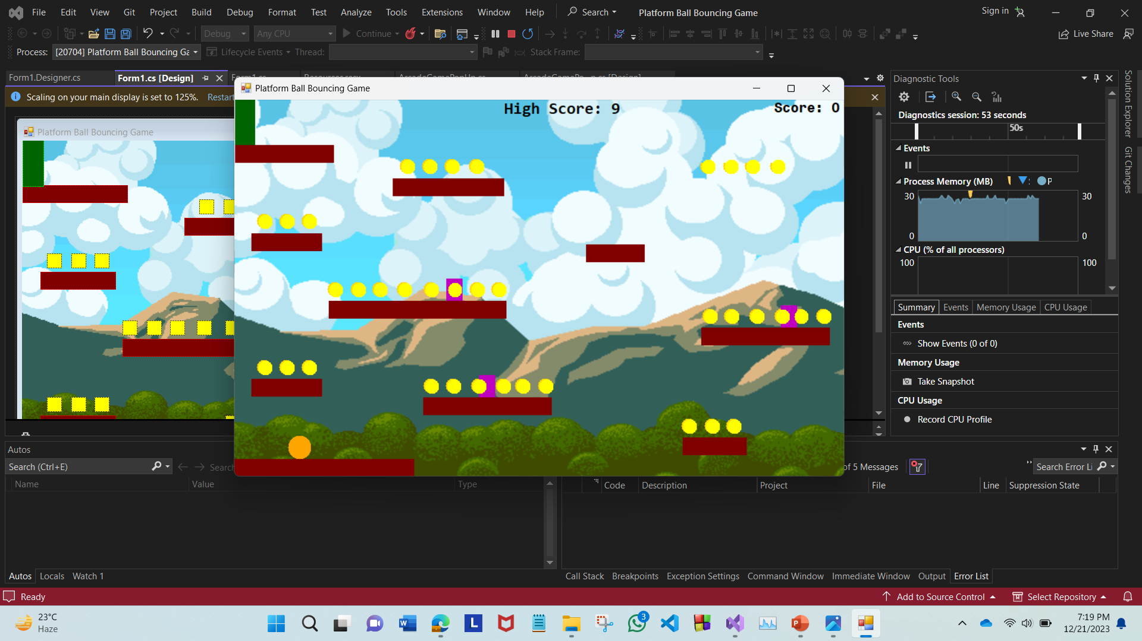
Score Label
Door
High Score Label
Dynamic Horizontal Platform
Moving Enemy
Floating Coins
Static Platform
Dynamic Vertical Platform
Background Image
Ball

Slide 34
Conclusion
In conclusion, Our Khela Ghor project has been a journey of creativity and programming skill development. Through the incorporation of diverse game concepts and thoughtful design, it showcases a culmination of effort and dedication. The project not only demonstrates technical proficiency but also reflects a passion for interactive entertainment. Overall, it stands as a testament to the potential for innovation and enjoyment within the realm of game development.

Slide 35

Thank You!

